Slide 1

Medium Access Control Sub Layer

Slide 2
Channel Allocation Problem
How to allocate a single broadcast channel among competing users
Static and dynamic schemes

Slide 3
Static Channel Allocation in LANs & MANs
FDM – Frequency Division Multiplexing
N users – bandwidth is divided into N equal sized portions
No interference between users
Used for small and constant number of users
Heavy load of traffic

Slide 4
TDM – Time Division Multiplexing
N users – Same bandwidth is shared but time slots are provided
Need to synchronize timer of all the users
Interference between users can be happen
Used when Average load of traffic

Slide 5

Based on Simple Queuing Theory:
Mean Time Delay T for channel capacity C bps,
Arrival rate
(frames/sec)
Service rate (frames/sec)

Slide 6

For Example:
C = 100 Mbps
Mean frame length 1/u = 10000 bits
Frame arrival time = 5000 frames/sec
Calculate mean time delay T
Now divide channel into N independent subchannel

Slide 7
Dynamic Channel Allocation in LANs & MANs
Five key Assumptions
Station Model (Terminal): station is blocked and does nothing until frame has been successfully transmitted
Single Channel Assumption : single channel is available for all communication
All stations are equivalent, although protocol s/w may assign priorities to them

Slide 8
Collision Assumption : all stations can detect collisions
Collide frame must be transmitted again later
Continuous Time : frame transmission can begin at any instant. No master clock dividing time slot discrete intervals
Slotted Time : time is divided into slots
A slot may contain 0, 1, or more frames, corresponding to an idle slot, a successful transmission, or collision, respectively

Slide 9
Carrier Sense : stations can tell if the channel is in use before trying to use it
If the channel is sensed as busy, no station will attempt to use it until it goes idle
No Carrier Sense : stations can not sense the channel before trying to use it.

Slide 10
Multiple Access Protocols
ALOHA
Pure ALOHA
Slotted ALOHA
CSMA
Collision Free Protocols

Slide 11
ALOHA
1970 – Norman Abramson and his colleagues at university of Hawaii
Used ground based radio broadcasting
Two versions of ALOHA : Pure & slotted
Differ with respect to time
Pure does not require global time synchronization, slotted does

Slide 12
Pure ALOHA
Lets users transmit whenever they have data to be sent
With LANs, feedback is immediate
With satellite, delay of 270 msec
System in which multiple users share common channel in a way that can lead to conflicts are widely known as contention systems

Slide 13

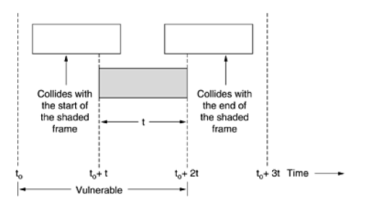
Throughput :
Max Throughput occurs at G = 0.5
So we will get S = 0.184 i.e. 18%

Slide 14

Slotted ALOHA
1972 – Roberts published a method for doubling the capacity of ALOHA system
Shared channel is divided in to number of discrete time intervals called slots
Station can transmit at the beginning of slot
Throughput :
Max Throughput occurs at G = 1
We get S = 0.368 i.e. 36%

Slide 15
Carrier Sense Multiple Access Protocols - CSMA
With slotted ALOHA best channel utilization that can be achieved is 1/e
Protocols in which stations listen for a carrier and act accordingly are called carrier sense protocols
Two types
Persistent CSMA – 1-Persistent & P-Persistent
Non Persistent CSMA

Slide 16
Persistent CSMA
When station has data to send, it first listens to the channel to see if anyone else is transmitting at that moment
If channel is busy, the station waits until it becomes idle
When the station detects an idle channel, it transmits a frame
Protocol is called 1-persistent because the station transmits with a probability of 1 when it finds channel idle

Slide 17
Non Persistent CSMA
If the channel is already in use, the station does not continually sense it for the purpose of seizing it immediately upon detecting the end of the previous transmission.
It waits a random period of time and then repeats the algorithm
Leads to better channel utilization but longer delays than 1- persistent CSMA

Slide 18
P – Persistent CSMA
Applies to slotted channels
It senses the channel
If it is idle, it transmits with a probability p
With a probability q = 1-p, it defers until next slot
If that slot is also idle, it either transmits or defers again, with probabilities p & q
If station initially senses channel busy, it waits until next slot and applies above algorithm

Slide 19
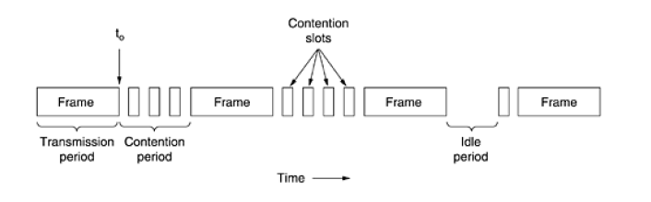
CSMA with Collision Detection

Slide 20
Collision free Protocols
A Bit Map Protocol : each contention period consists of exactly N slots
If station 0 has a frame to send, it transmits a 1 bit during zeroth slot
No other station is allowed to transmit during this slot
Protocol in which the desire to transmit is broadcast before the actual transmission are called reservation protocols

Slide 21
On average, station will have to wait N/2 slots for the current scan to finish and another N slots for the following scan to run to completion before it may begin transmitting
At high load, when all stations have something to send all the time, N bit contention period is prorated over N frames, yielding on overhead of only 1 bit per frame, or an efficiency of d/(d+1)
Mean delay for a frame is equal to sum of time it queues inside its station, plus additional N(D+1)/2 once it gets ti the head of its internal queue

Slide 22
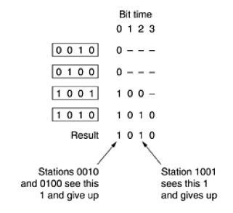
Binary Countdown : a station wanting to use the channel broadcasts its address as a binary bit string, starting with the high order bit
The bits in each address position from different stations are BOOLEAN ORed together

Slide 23
Limited Contention Protocols
For light load – contention is preferable due to low delay
Heavy load – collision free
Two case : symmetric & asymmetric

Slide 24

Symmetric : suppose k stations , probability is p for transmitting during each slot
Probability that some station successfully acquires channel during given slot is kp(1-p)^{(k-1)}
The best value of p is 1/k, substituting p = 1/k
We get,

Slide 25
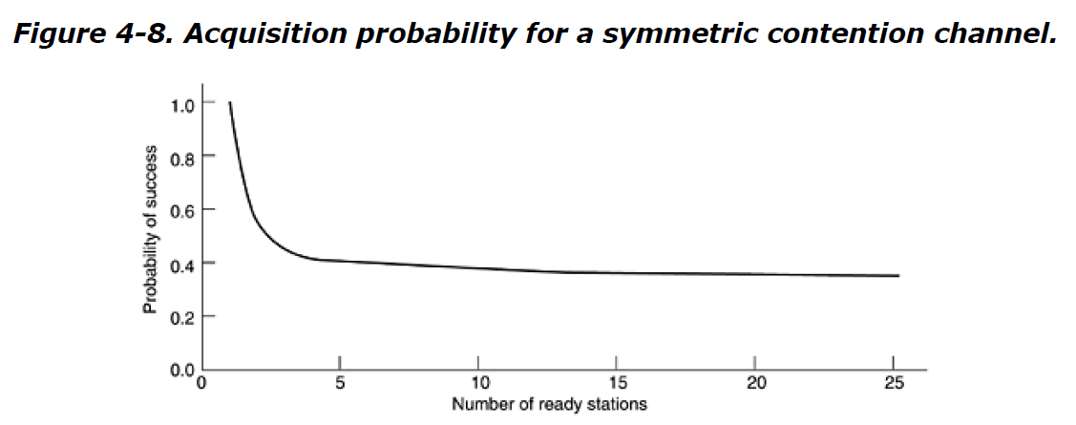
To increase acquisition probability – Need to decrease the amount of competition between stations
Limited Contention Protocol works on this principle
It divides the stations in small groups and for particular slot only members of particular groups can compete with each other

Slide 26
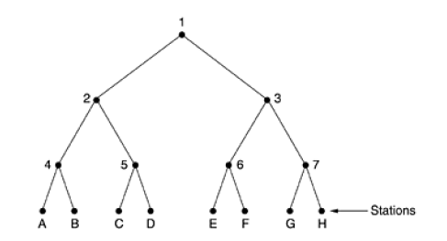
Adaptive Tree Walk Protocol :

Slide 27
Wavelength Division Multiple Access Protocols
To allow multiple transmission at the same time, the spectrum is divided into channels. This protocol is known as WDMA
Each station is assigned two channels.
Narrow channel is provided as a control channel to signal the station
Wide channel is provided so that station can output data frames

Slide 28
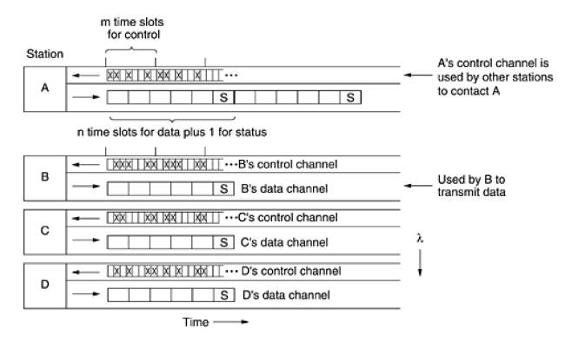
Each channel is divided into groups of time slots

Slide 29
Protocol supports 3 traffic classes :
Constant data rate connection oriented traffic, such as uncompressed video
Variable data rate connection oriented traffic, such as file transfer
Datagram traffic, such as UDP packets
For connection oriented, A to communicate with B, it must insert connection request frame in B’s control channel
If b accepts, communication can take place on A’s data Channel

Slide 30
Each station has 2 transmitters and 2 receivers
Fixed wavelength receiver for listening to its own control channel
Tunable transmitter for sending on other station’s control channels
Fixed wavelength transmitter for outputting data frames
Tunable receiver for selecting data transmitter to listen to
When a large number of frequencies are being used, the system is called Dense Wavelength Division Multiplexing

Slide 31
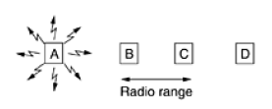
Wireless LAN Protocols
Hidden Station Problem

Slide 32
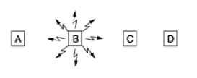
Exposed Station Problem

Slide 33
MACA – Multiple Access with Collision Avoidance
Sender to stimulate the receiver into outputting a short frame, so stations nearby can detect this transmission and avoid transmitting for the duration of upcoming data frame

Slide 34
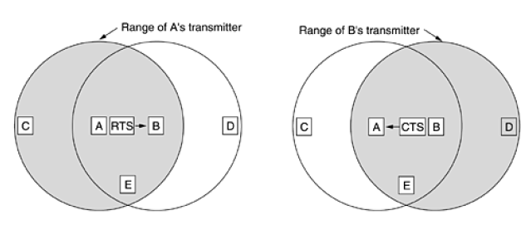
Request To Send
Clear To Send

Slide 35
MACAW – MACA for Wireless
Without data link layer acknowledgements, lost frames were not retransmitted until transport layer noticed their absence.
To solve this, introduced ACK frame after each successful data frame
Decided to run back-off algorithm separately for each data stream rather than for each station

Slide 36
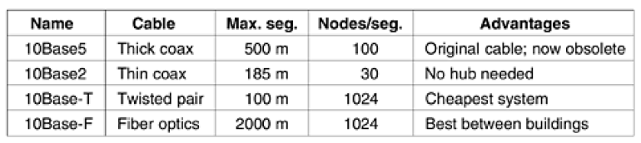
Ethernet
Types of Ethernet
Classic Ethernet Switched Ethernet
Solves multiple access problem Devices connected using switch
3-10 Mbps 100Mbps, 1000Mbps, 10000Mbps
Original form Fast Ethernet, Gigabit Ethernet

Slide 37
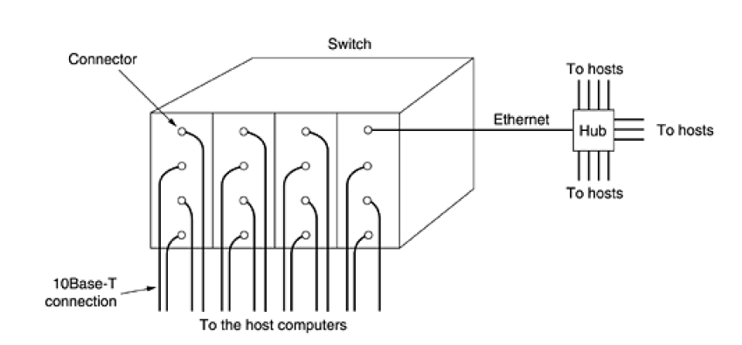
Switched Ethernet

Slide 38
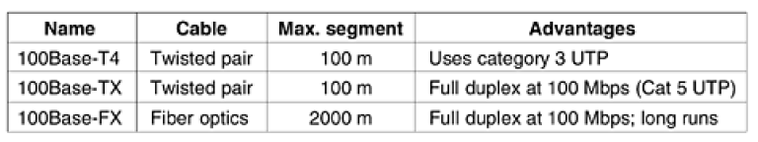
Fast Ethernet
802.3u - 1995
Reduce bit time from 100ns to 10ns

Slide 39
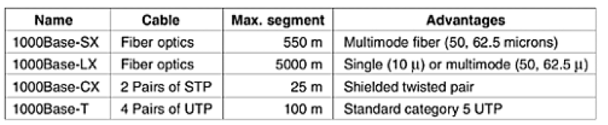
Gigabit Ethernet
802.3ab – 1999

Slide 40
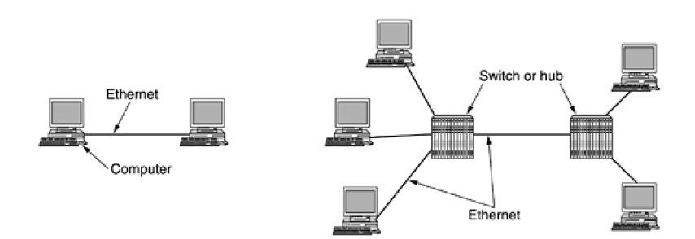
Frame bursting
Carrier extension – 512 bytes
Jumbo frames – 1500 bytes

Slide 41
802.2 – Logical Link Control - LLC
LLC forms the upper half of the data link layer, with the MAC sublayer below it
LLC (Logical Link Control), hides the differences between the various kinds of 802 networks by providing a single format and interface to the network layer.
LLC add sequence number and acknowledgement number
3 Services - unreliable datagram service, acknowledged datagram service, and reliable connection-oriented service

Slide 42
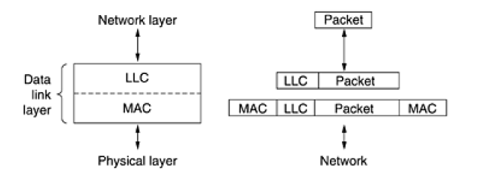
LLC header contains 3 fields:
Destination Access Point
Source Access Point
Control Field

Slide 43
Data link layer switching
Bridges
mechanism use – flooding, back learning
Prepare hash table
3 conditions
if the port for destination address is same source address – discard
if different – forward
if not found - flooding

